Slide 1


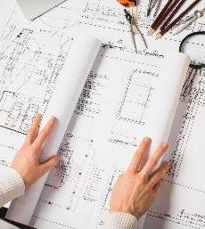

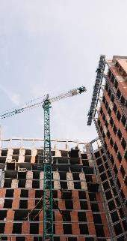


HOUSE PRICE PREDICTION
18CSC305J - Artificial intelligence

Slide 2
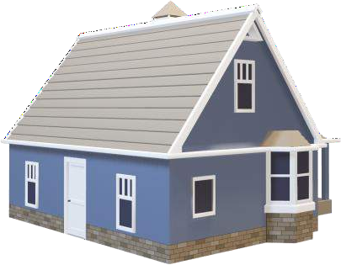

Team Members
Sneha Jana
RA2111026010363
Prithvi Pandaala RA2111026010364
T.S.Kaviyashruthi RA2111026010405

Slide 3
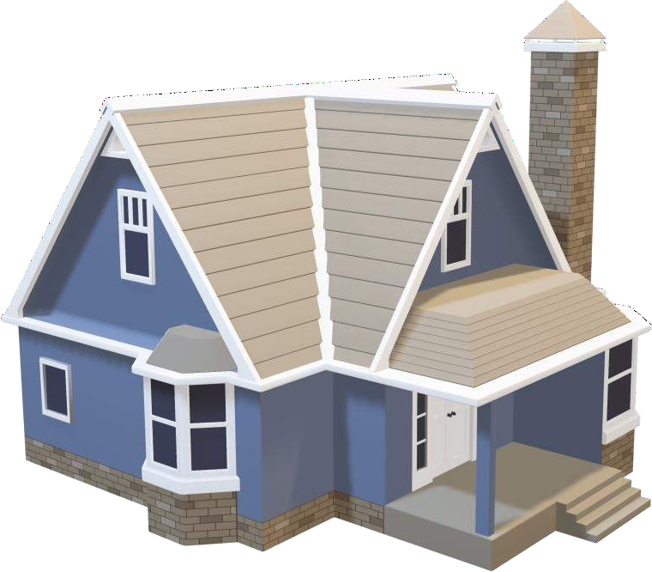
INTRODUCTION
Our House Price Prediction AI Project utilizes cutting- edge Artificial Intelligence algorithms to accurately forecast house prices. Leveraging advanced machine learning techniques, we provide stakeholders with invaluable insights for informed decision-making in the dynamic real estate market.

Slide 4
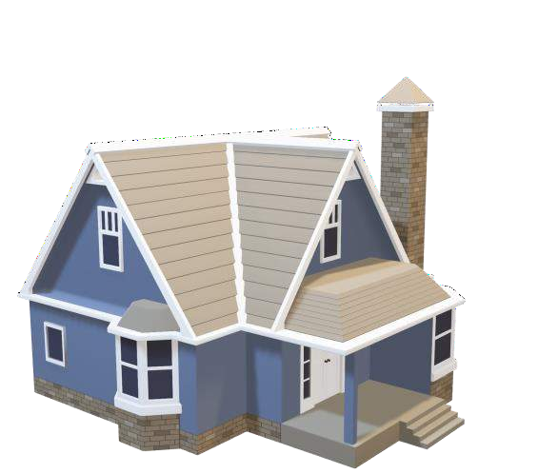
Problem Statement
In the real estate industry, accurately predicting house prices is challenging due to the multitude of factors influencing property values, including location, size, amenities, economic indicators, and market trends. Traditional methods often lack precision and rely heavily on manual analysis, leading to potential errors and inefficiencies.
Therefore, there is a critical need for an AI-powered solution that can analyze vast datasets, identify relevant patterns, and provide reliable predictions to assist buyers, sellers, and investors in navigating the complex housing market landscape.

Slide 5
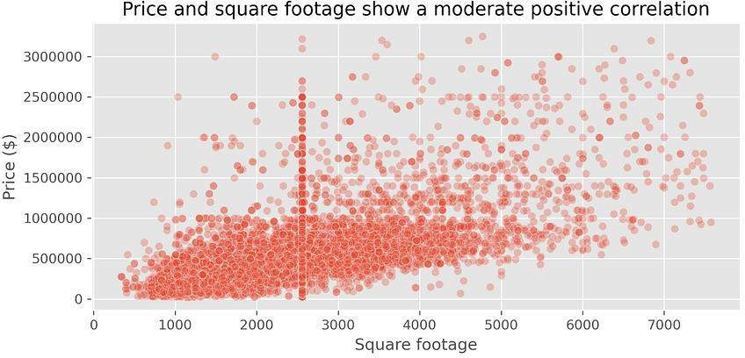
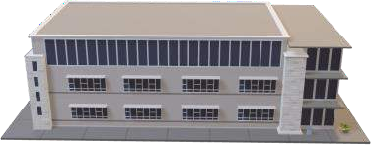
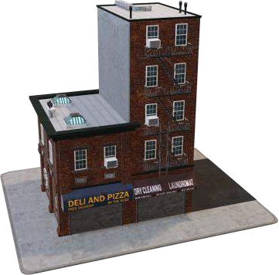

Factors Affecting House Prices
Schools
Shopping Malls
Highways
Grocery Stores

Slide 6



Existing System
The current methods for predicting house prices rely on manual analysis and simplistic statistical models, which are often time-consuming, subjective, and lack accuracy. These methods struggle to handle large datasets and may overlook subtle patterns in the data, hindering efficiency in decision-making processes.
Therefore, there is a clear need for a more advanced and automated approach leveraging AI technology to improve the accuracy and efficiency of house price predictions.

Slide 7
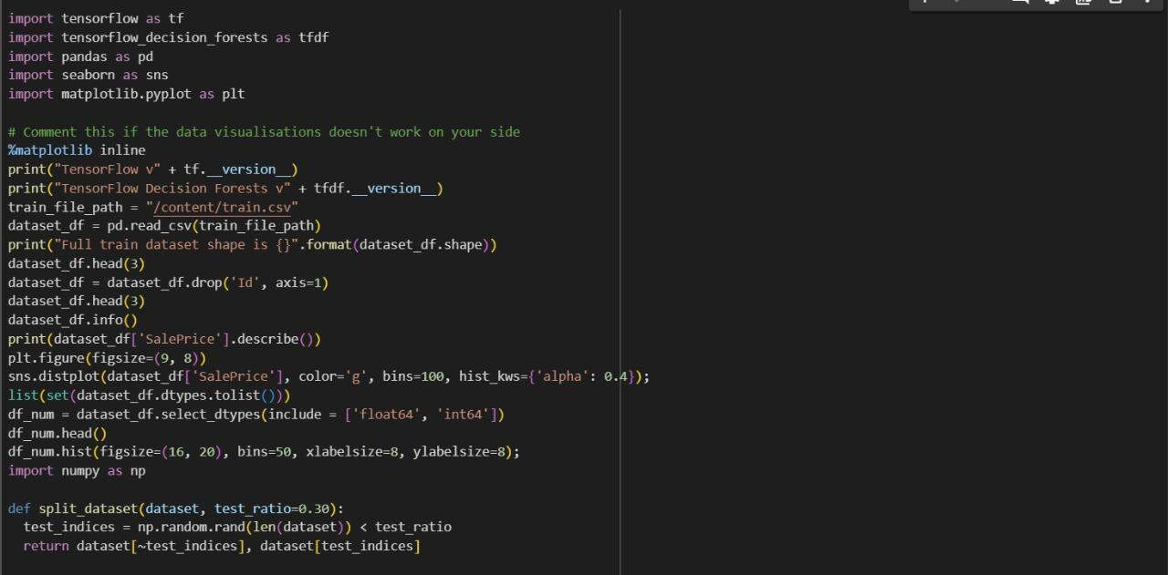

Slide 8
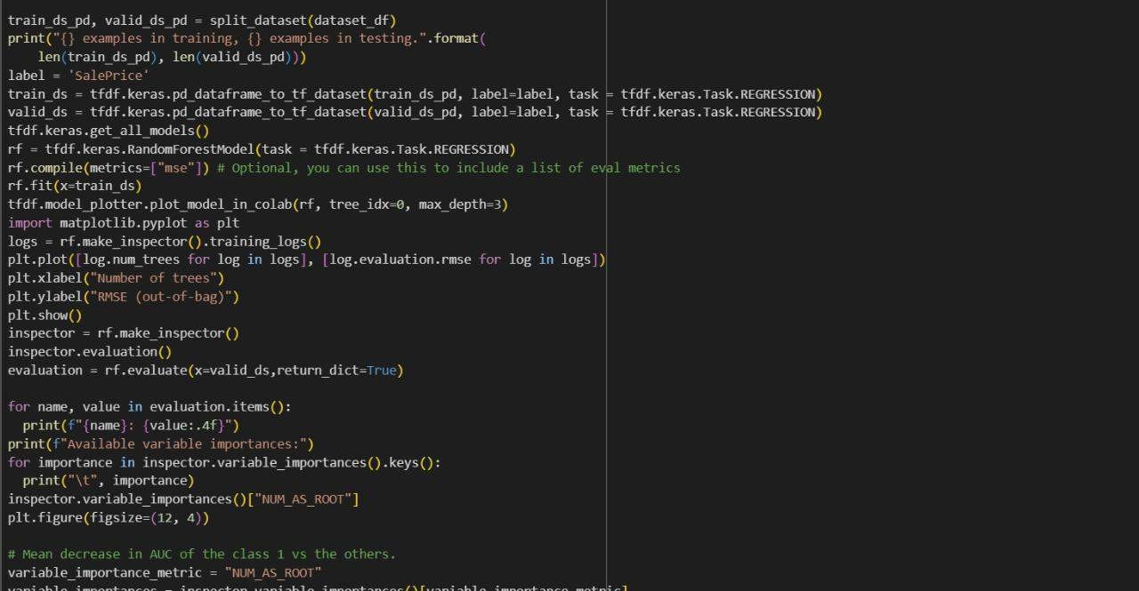


Slide 9
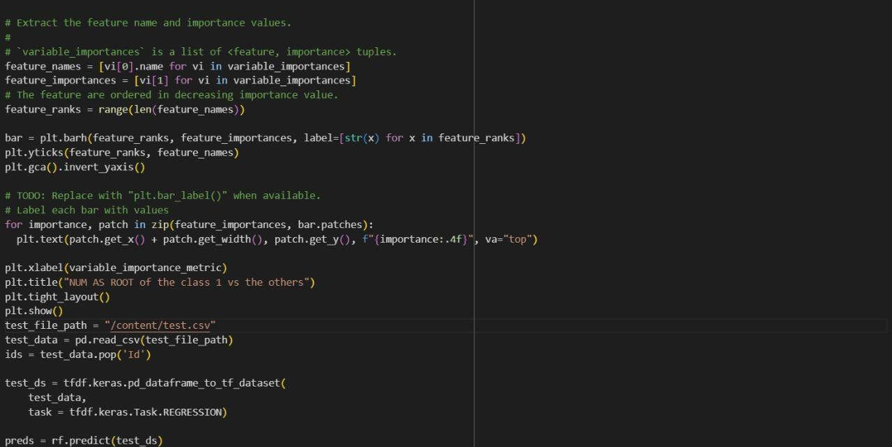

Slide 10
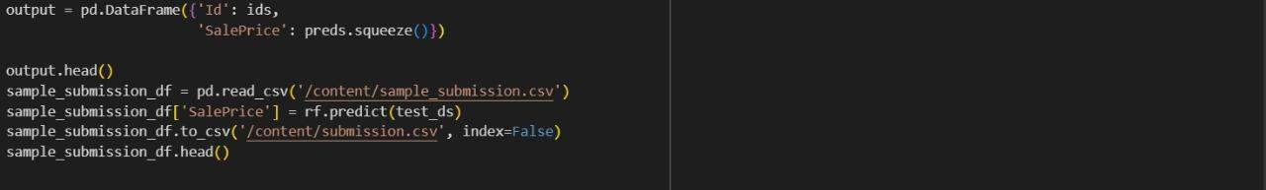

Slide 11
Thank You

